Slide 1
Sustaining the San Community’s livelihoods through Social Innovation
Prof R. Moalosi

Slide 2
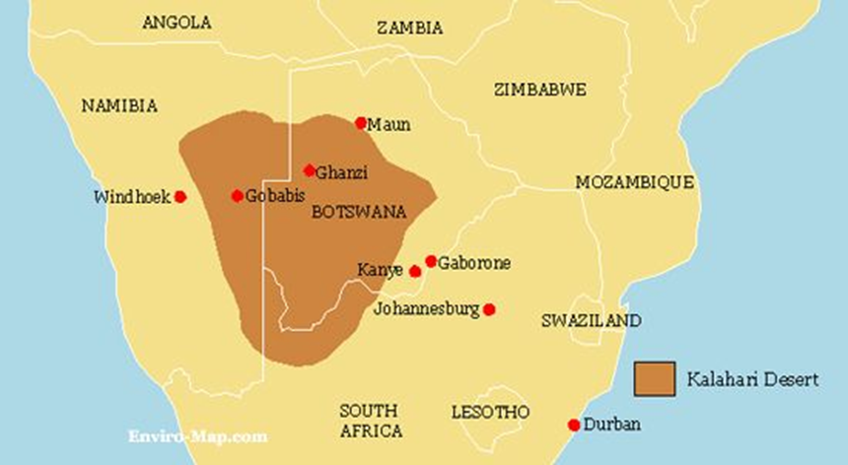
Introduction
Bushmen/San/Basarwa are original inhabitants of Southern Africa
Found in the Kalahari desert
Most creative, ingenious and resilient societies in Botswana

Slide 3
Introduction
Traditional living styles were derived from hunting and gathering.
Due to the promotion of tourism to diversify the economy, wildlife is highly protected.
The hunting bans, has disconnected them from their traditional way of life.

Slide 4
Introduction
Forced them to change their livelihoods to wage labour and agro-pastoralism, art and crafts, and community based natural resource management.
They face challenges such as poor education, unemployment, discrimination, forced removals from game reserves, economic hardship due to lack of economic opportunities in the context, etc.

Slide 5
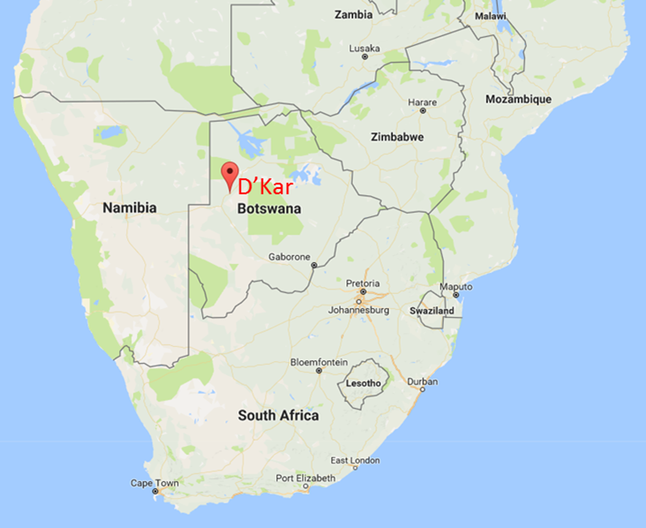
International Design for Development Summit
Organised an International Design for Development Summit at D’kar village.
In partnership with Massachusetts Institute of Technology, USA & These Hands (NGO), Botswana.
Attracted 27 international participants & 10 local participants

Slide 6
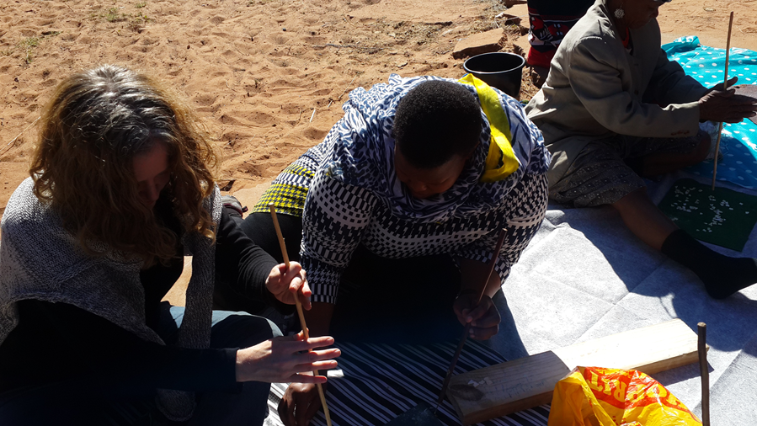
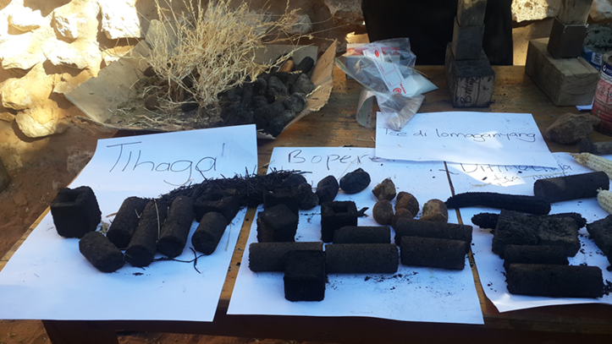
Scooping Exercise
Go through the gate keepers/ village elders/chief
San taught participants traditional technologies (making bow & arrow, fire making and ostrich eggshell making, etc.) to appreciate any production challenges.
Visiting participants also taught them appropriate technologies e.g., making briquettes from waste.

Slide 7
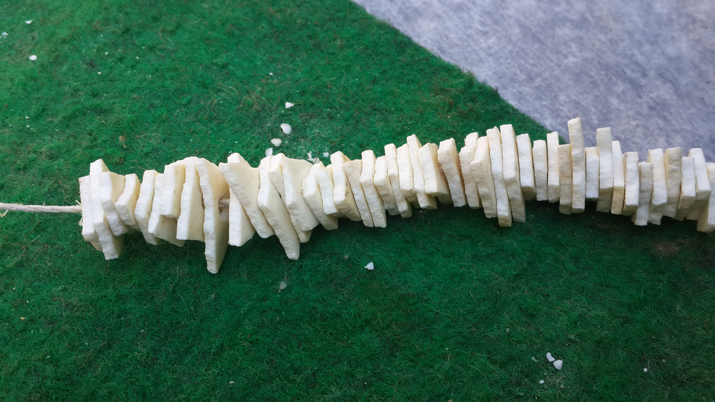
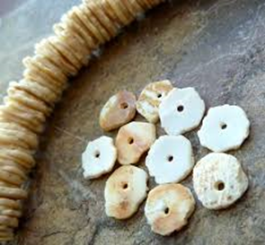
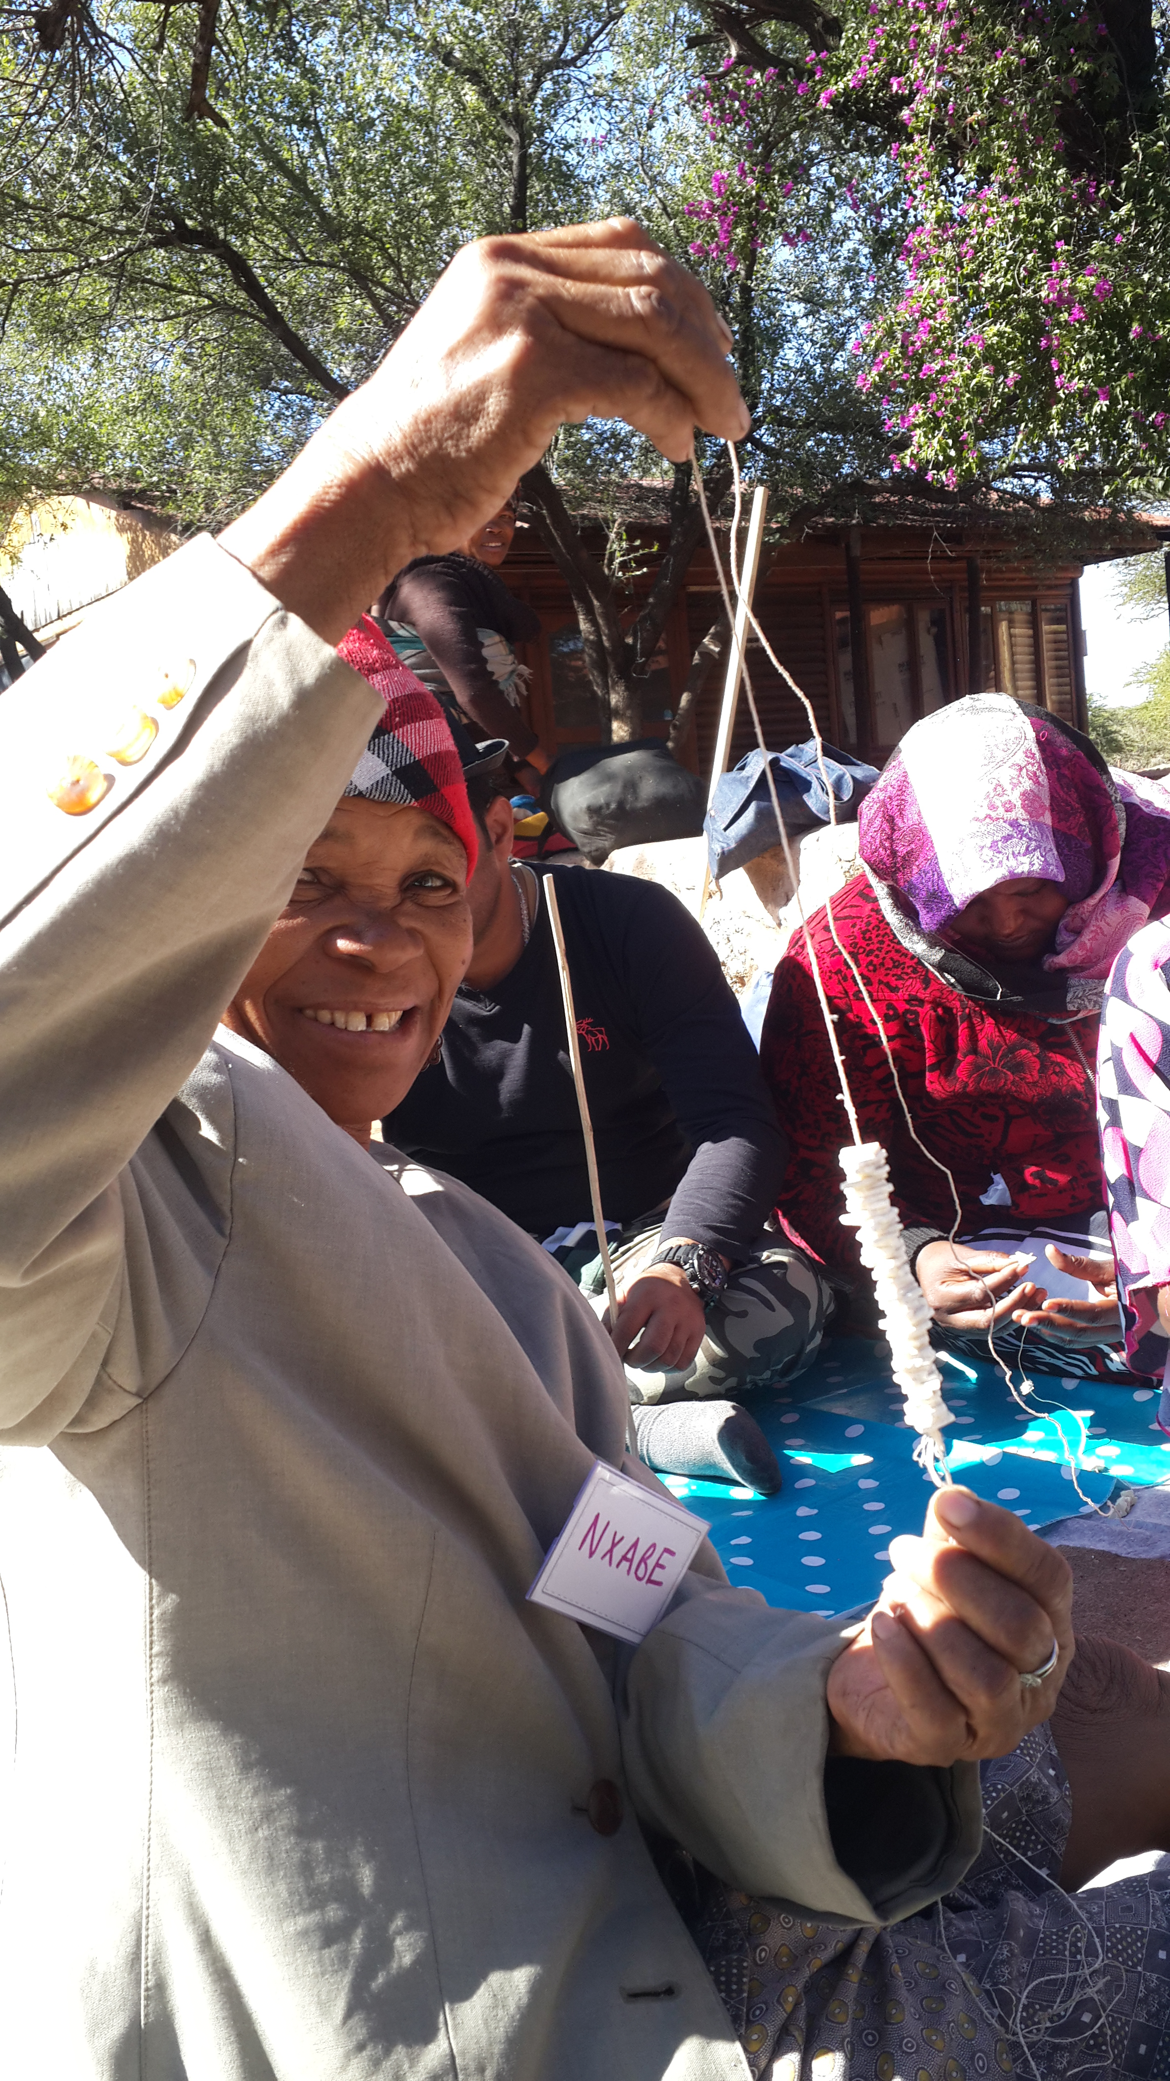
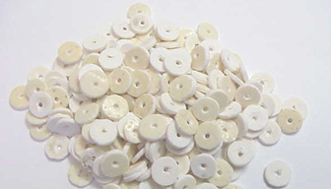
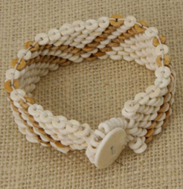
Ostrich Egg Shells Production

Slide 8
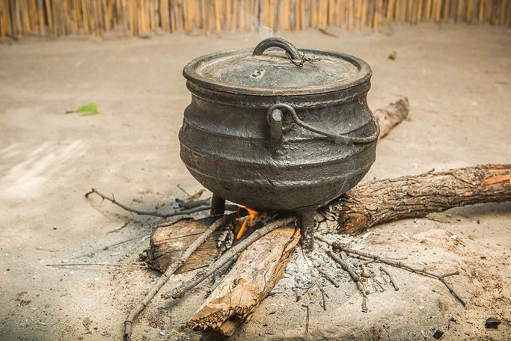
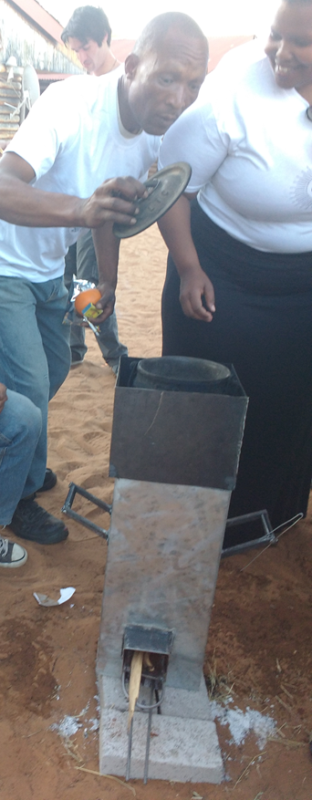
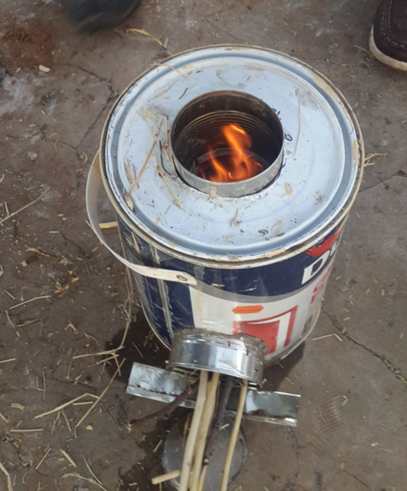
Eco-Efficient Stove

Slide 9
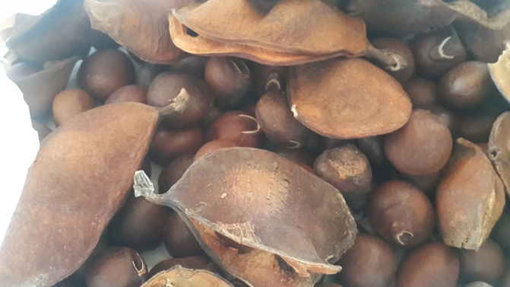
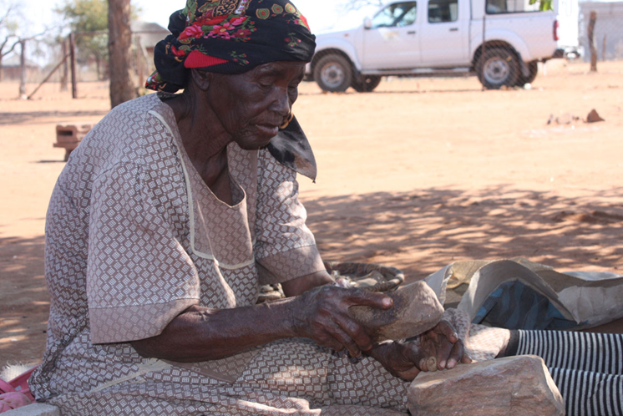
Morama Beans Project
Morama (Tylosema esculentum) is an indigenous bean of the Kalahari Desert.
It is a valued and healthy source of food & income for local families.
Traditional method for shelling the bean is time-consuming, laborious and can cause injuries.

Slide 10
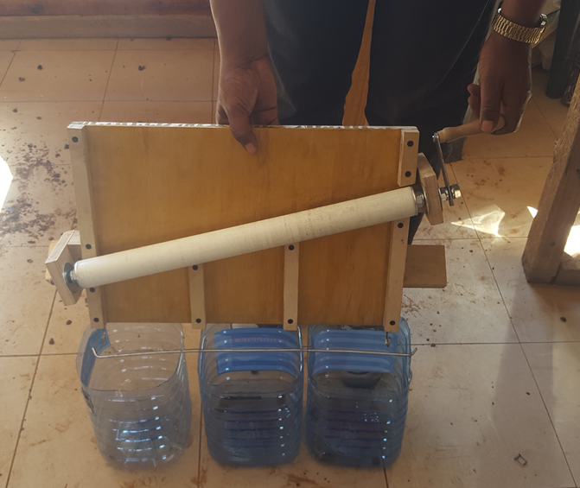
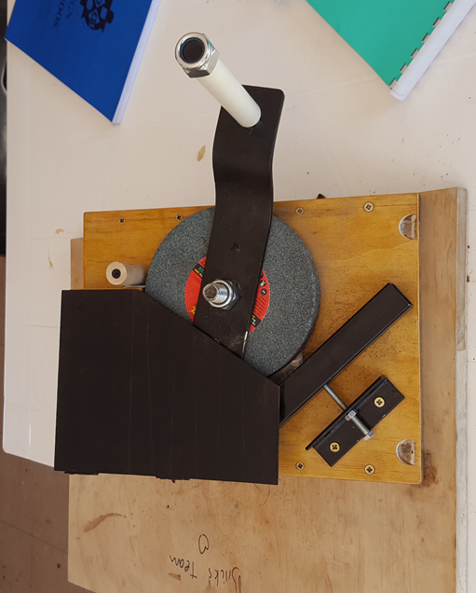
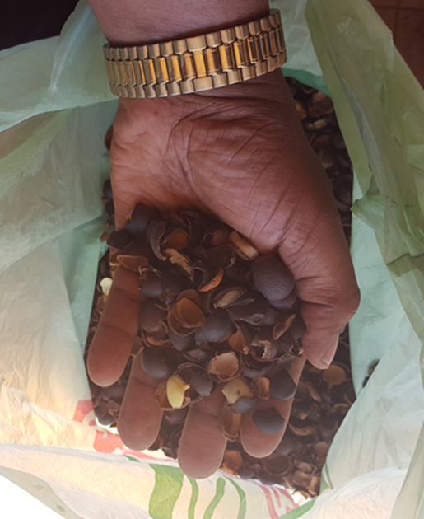
Aggregating the beans & Bean cracker
1
2
3
4

Slide 11
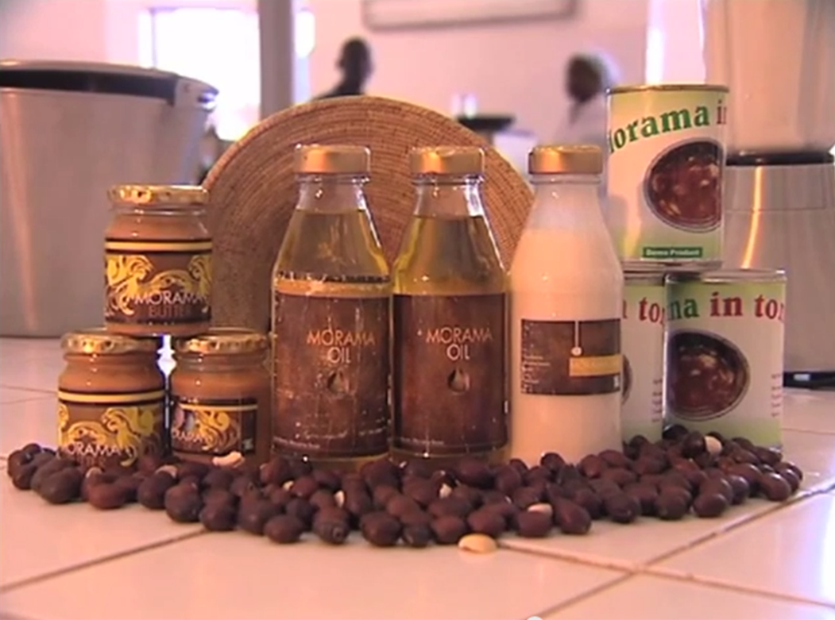
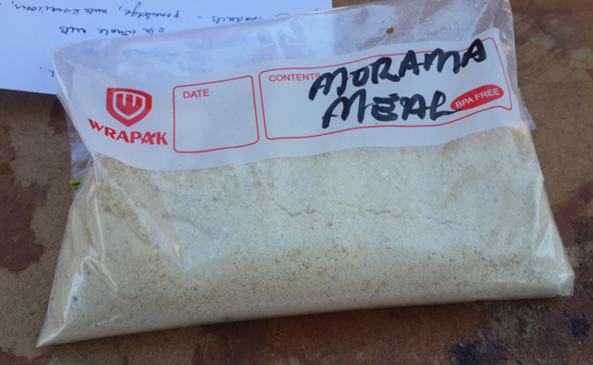
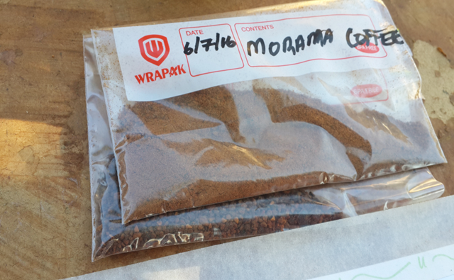
Morama Products

Slide 12
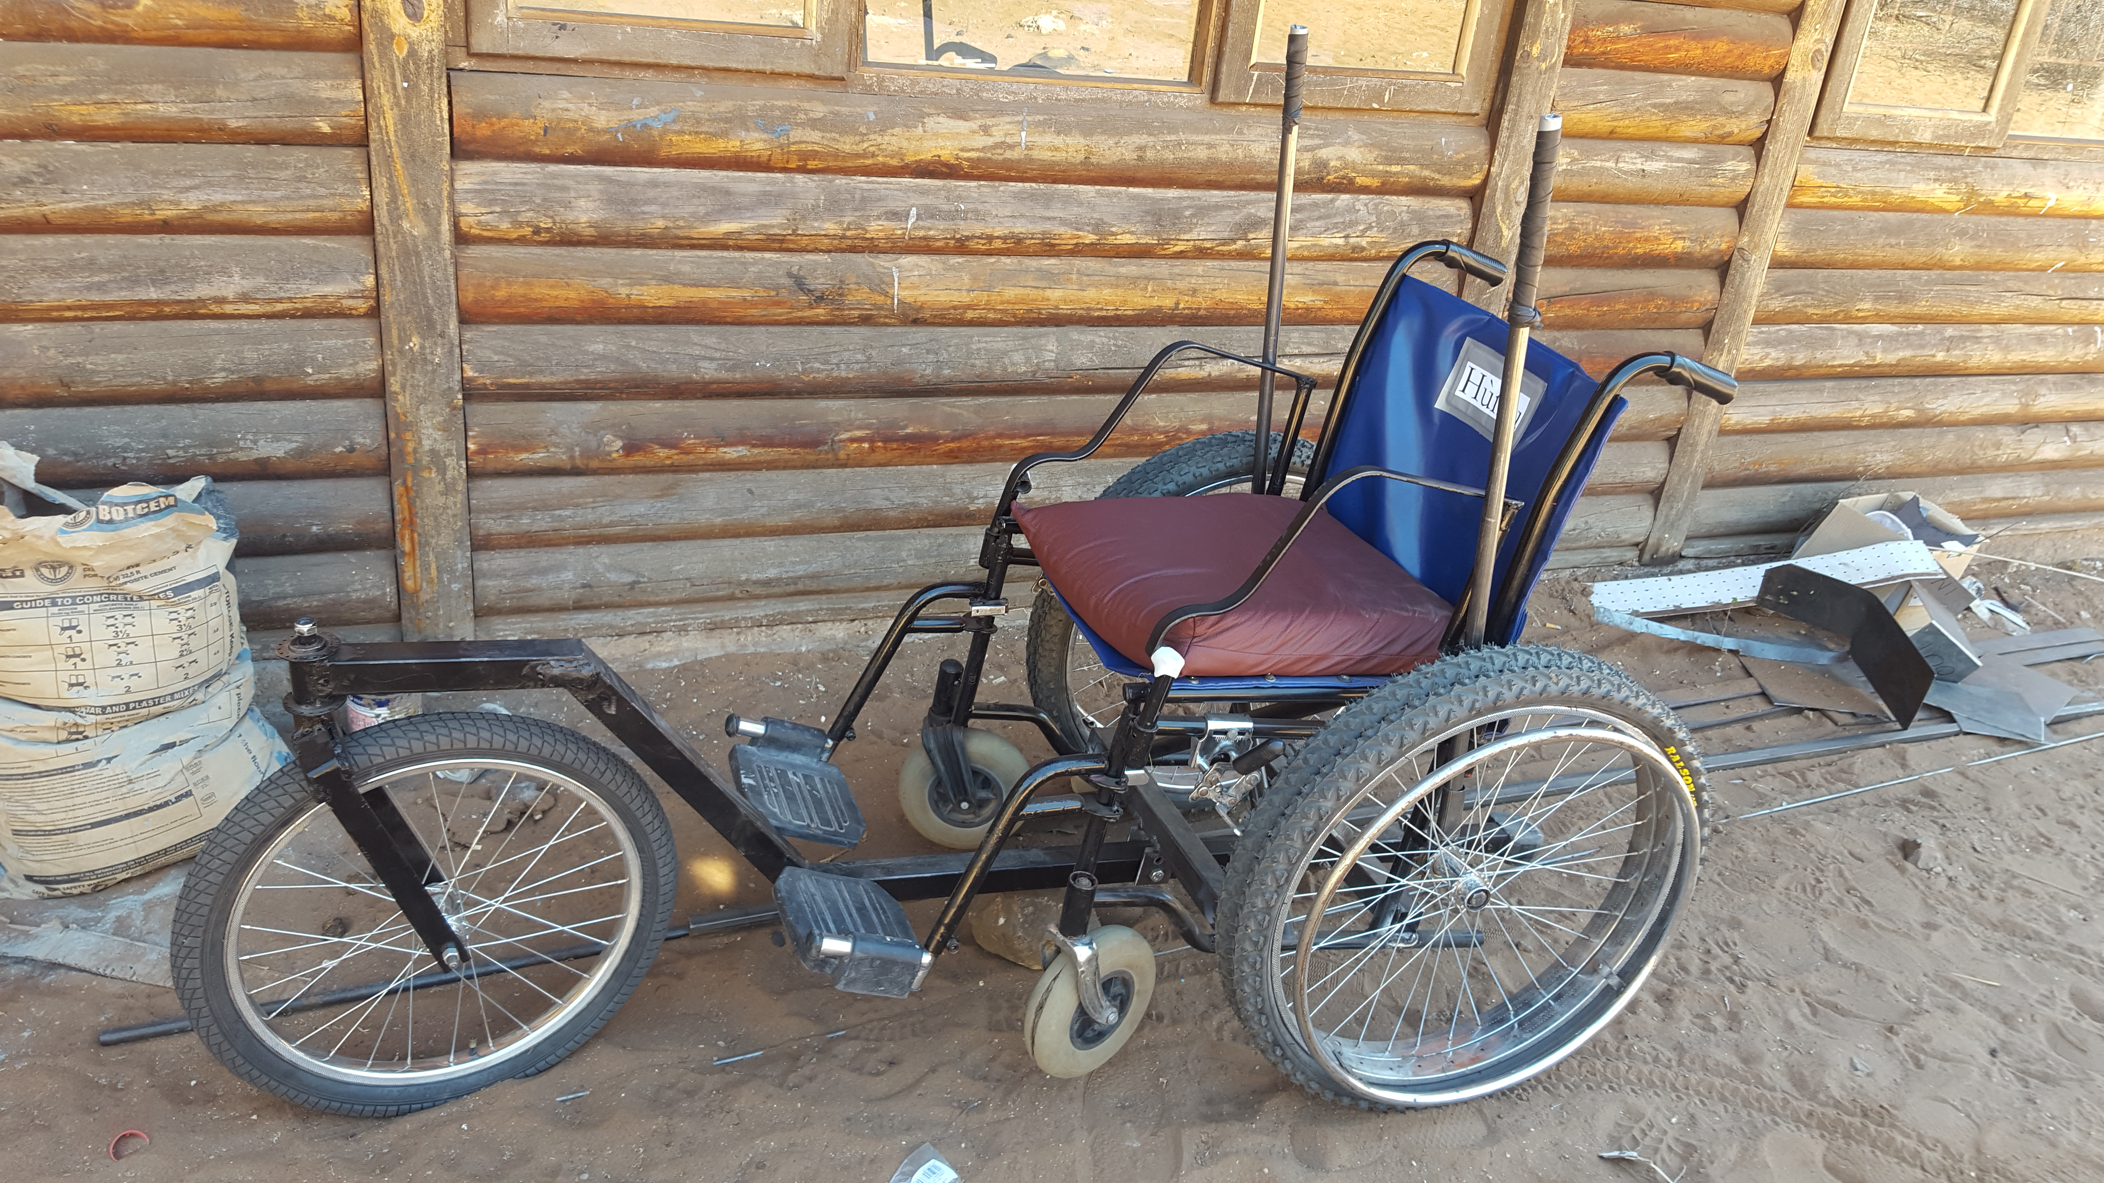
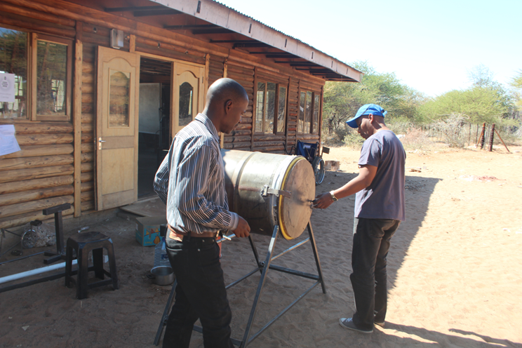
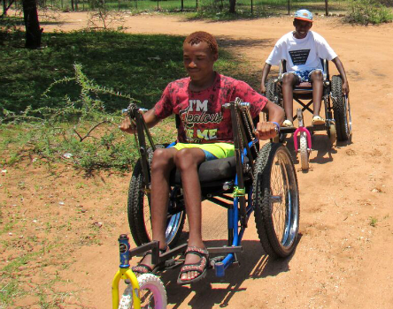
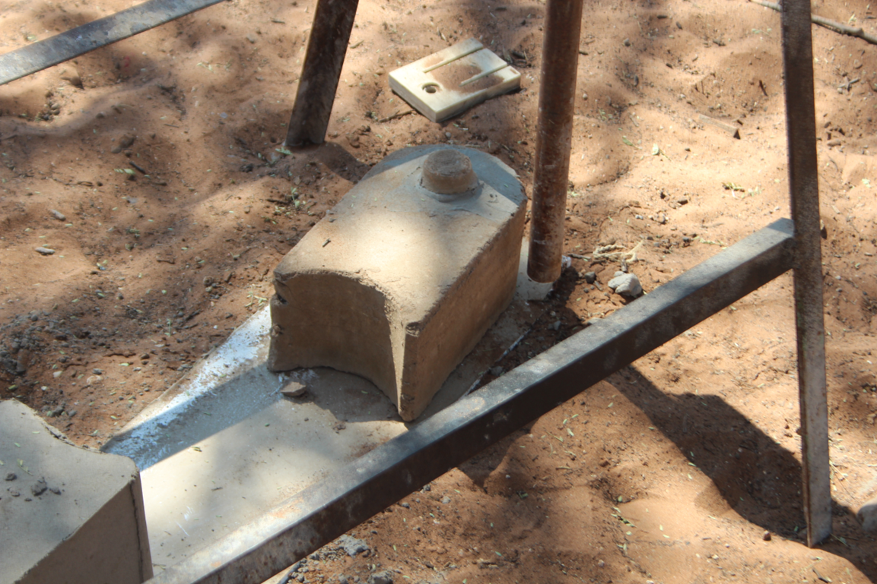
Sandy wheel-chair design, Manually-powered Washing Machine & Interlocking bricks

Slide 13
Conclusion
The community needs social infrastructure to co-create something meaningful to gain new innovation skills.
The community gained an Innovation Centre managed by the Village leadership.
University played a role in giving back to the community.
The project contributed to the attaining of the following SDGs:
GOAL 1: No Poverty GOAL 2: Zero Hunger
GOAL 5: Gender Equality GOAL 7: Affordable and Clean Energy
GOAL 8: Decent Work and Economic Growth GOAL 10: Reduced Inequality

Slide 14
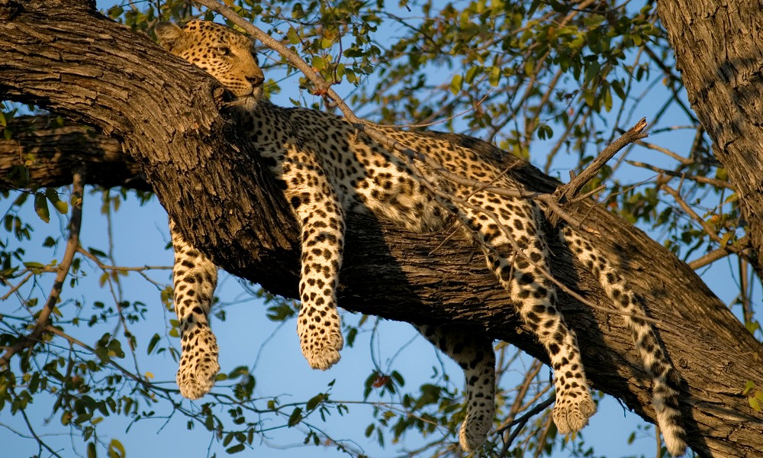

Slide 15
Thank you
moalosi@ub.ac.bw

