Slide 1
FF27: Rural Social Innovation
Projektbeispiele Silicon Vilstal project examples from Silicon Vilstal

Slide 2
„The region is the lab“
Three main principles 1. Leverage traditional culture 2. Just do it (start with „tryability“) 3. Offer shared & positive experiences

Slide 3
Silicon Vilstal Experience Festival
Europe‘s largest ESER event Sep 21-24, 2023

Slide 4
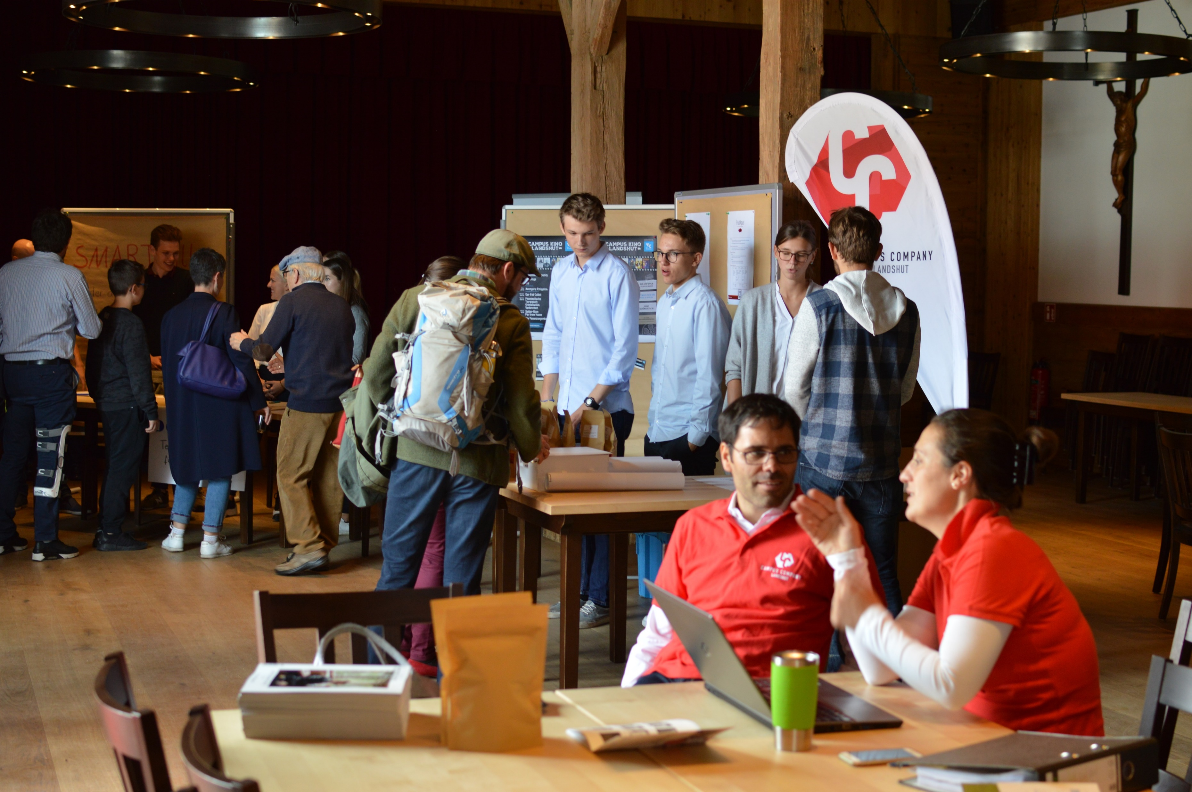
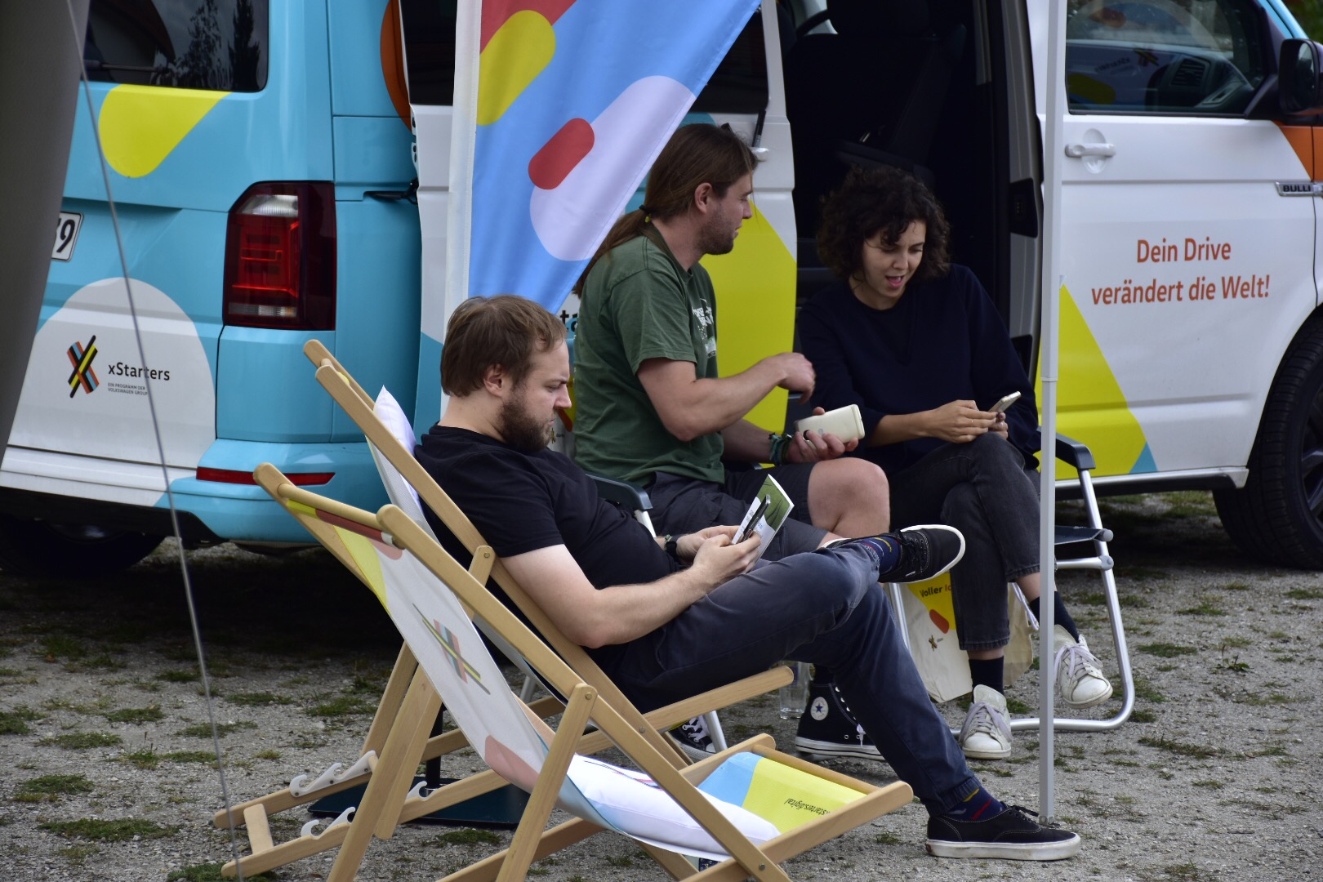
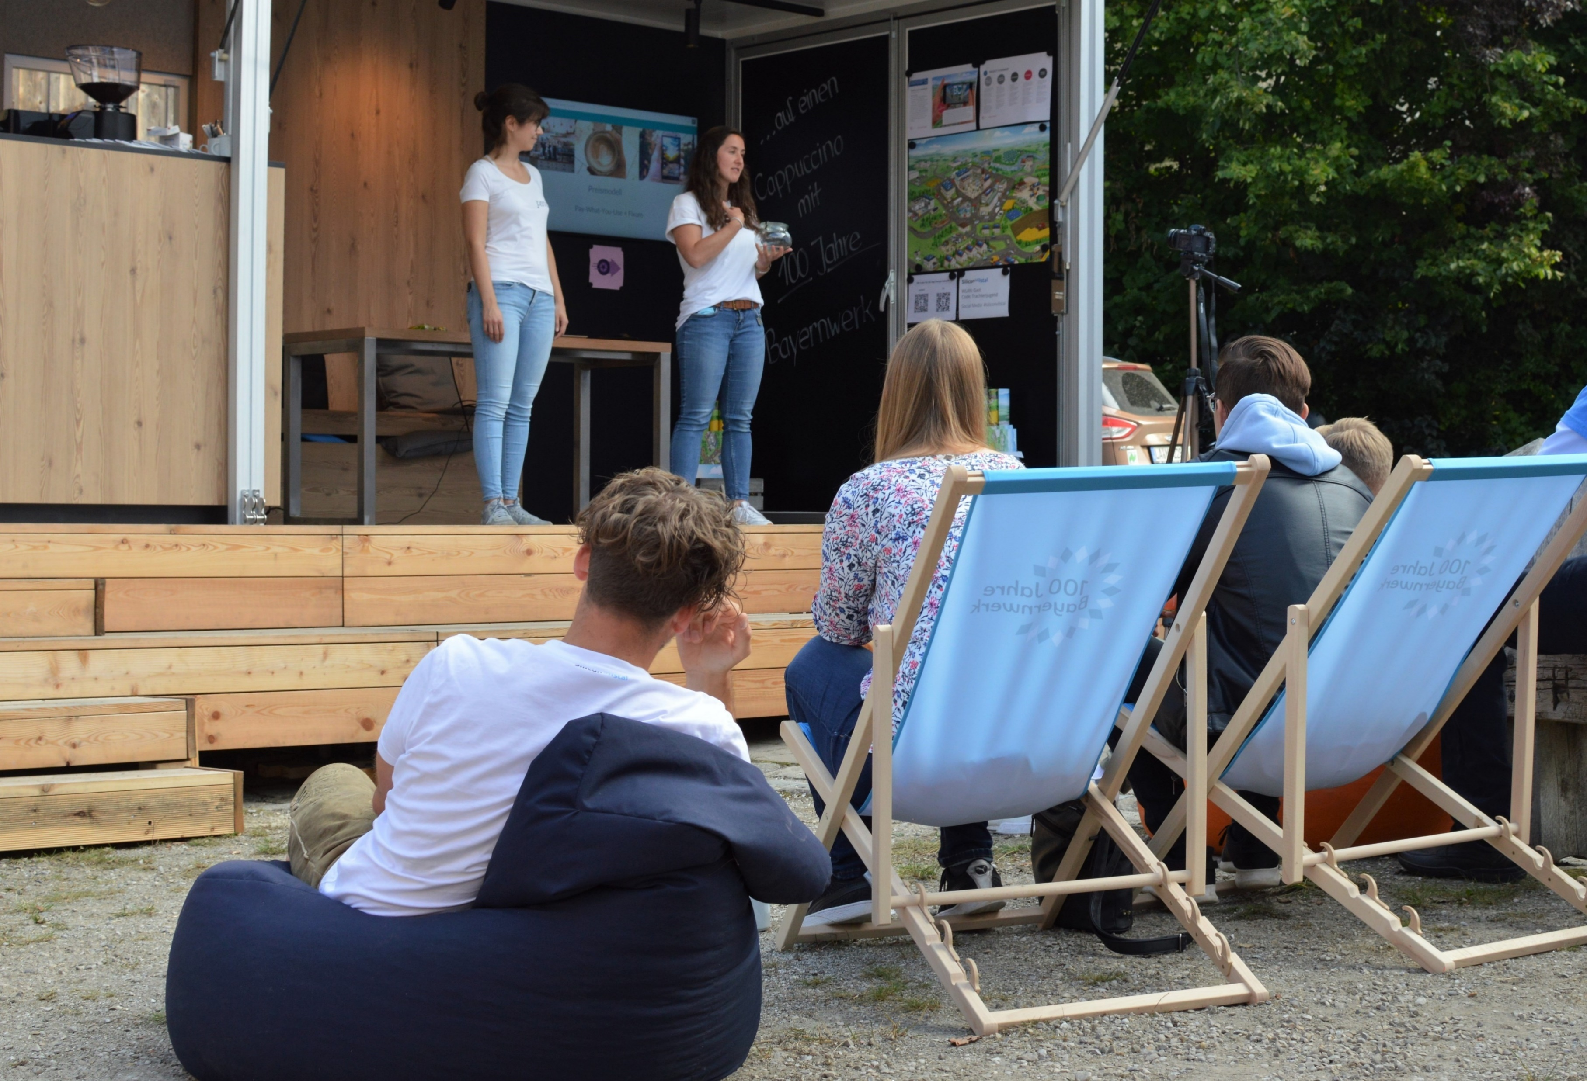
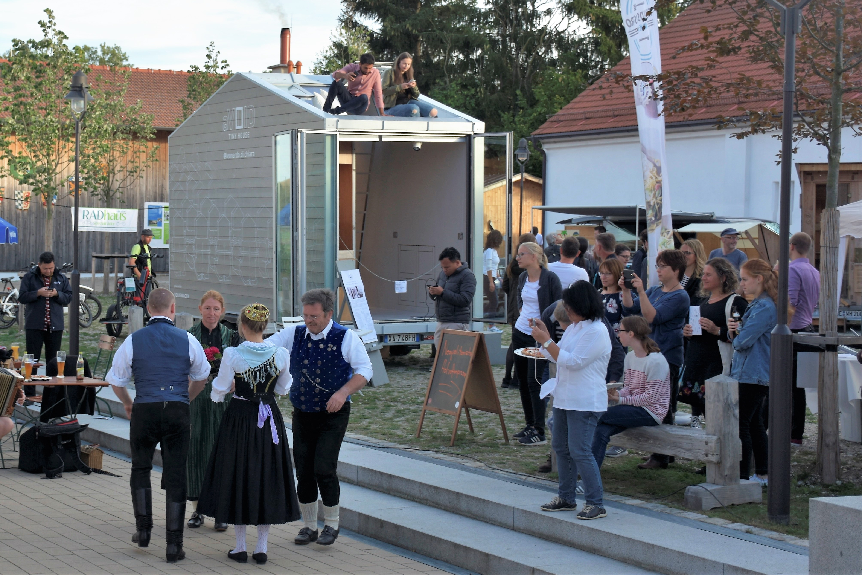
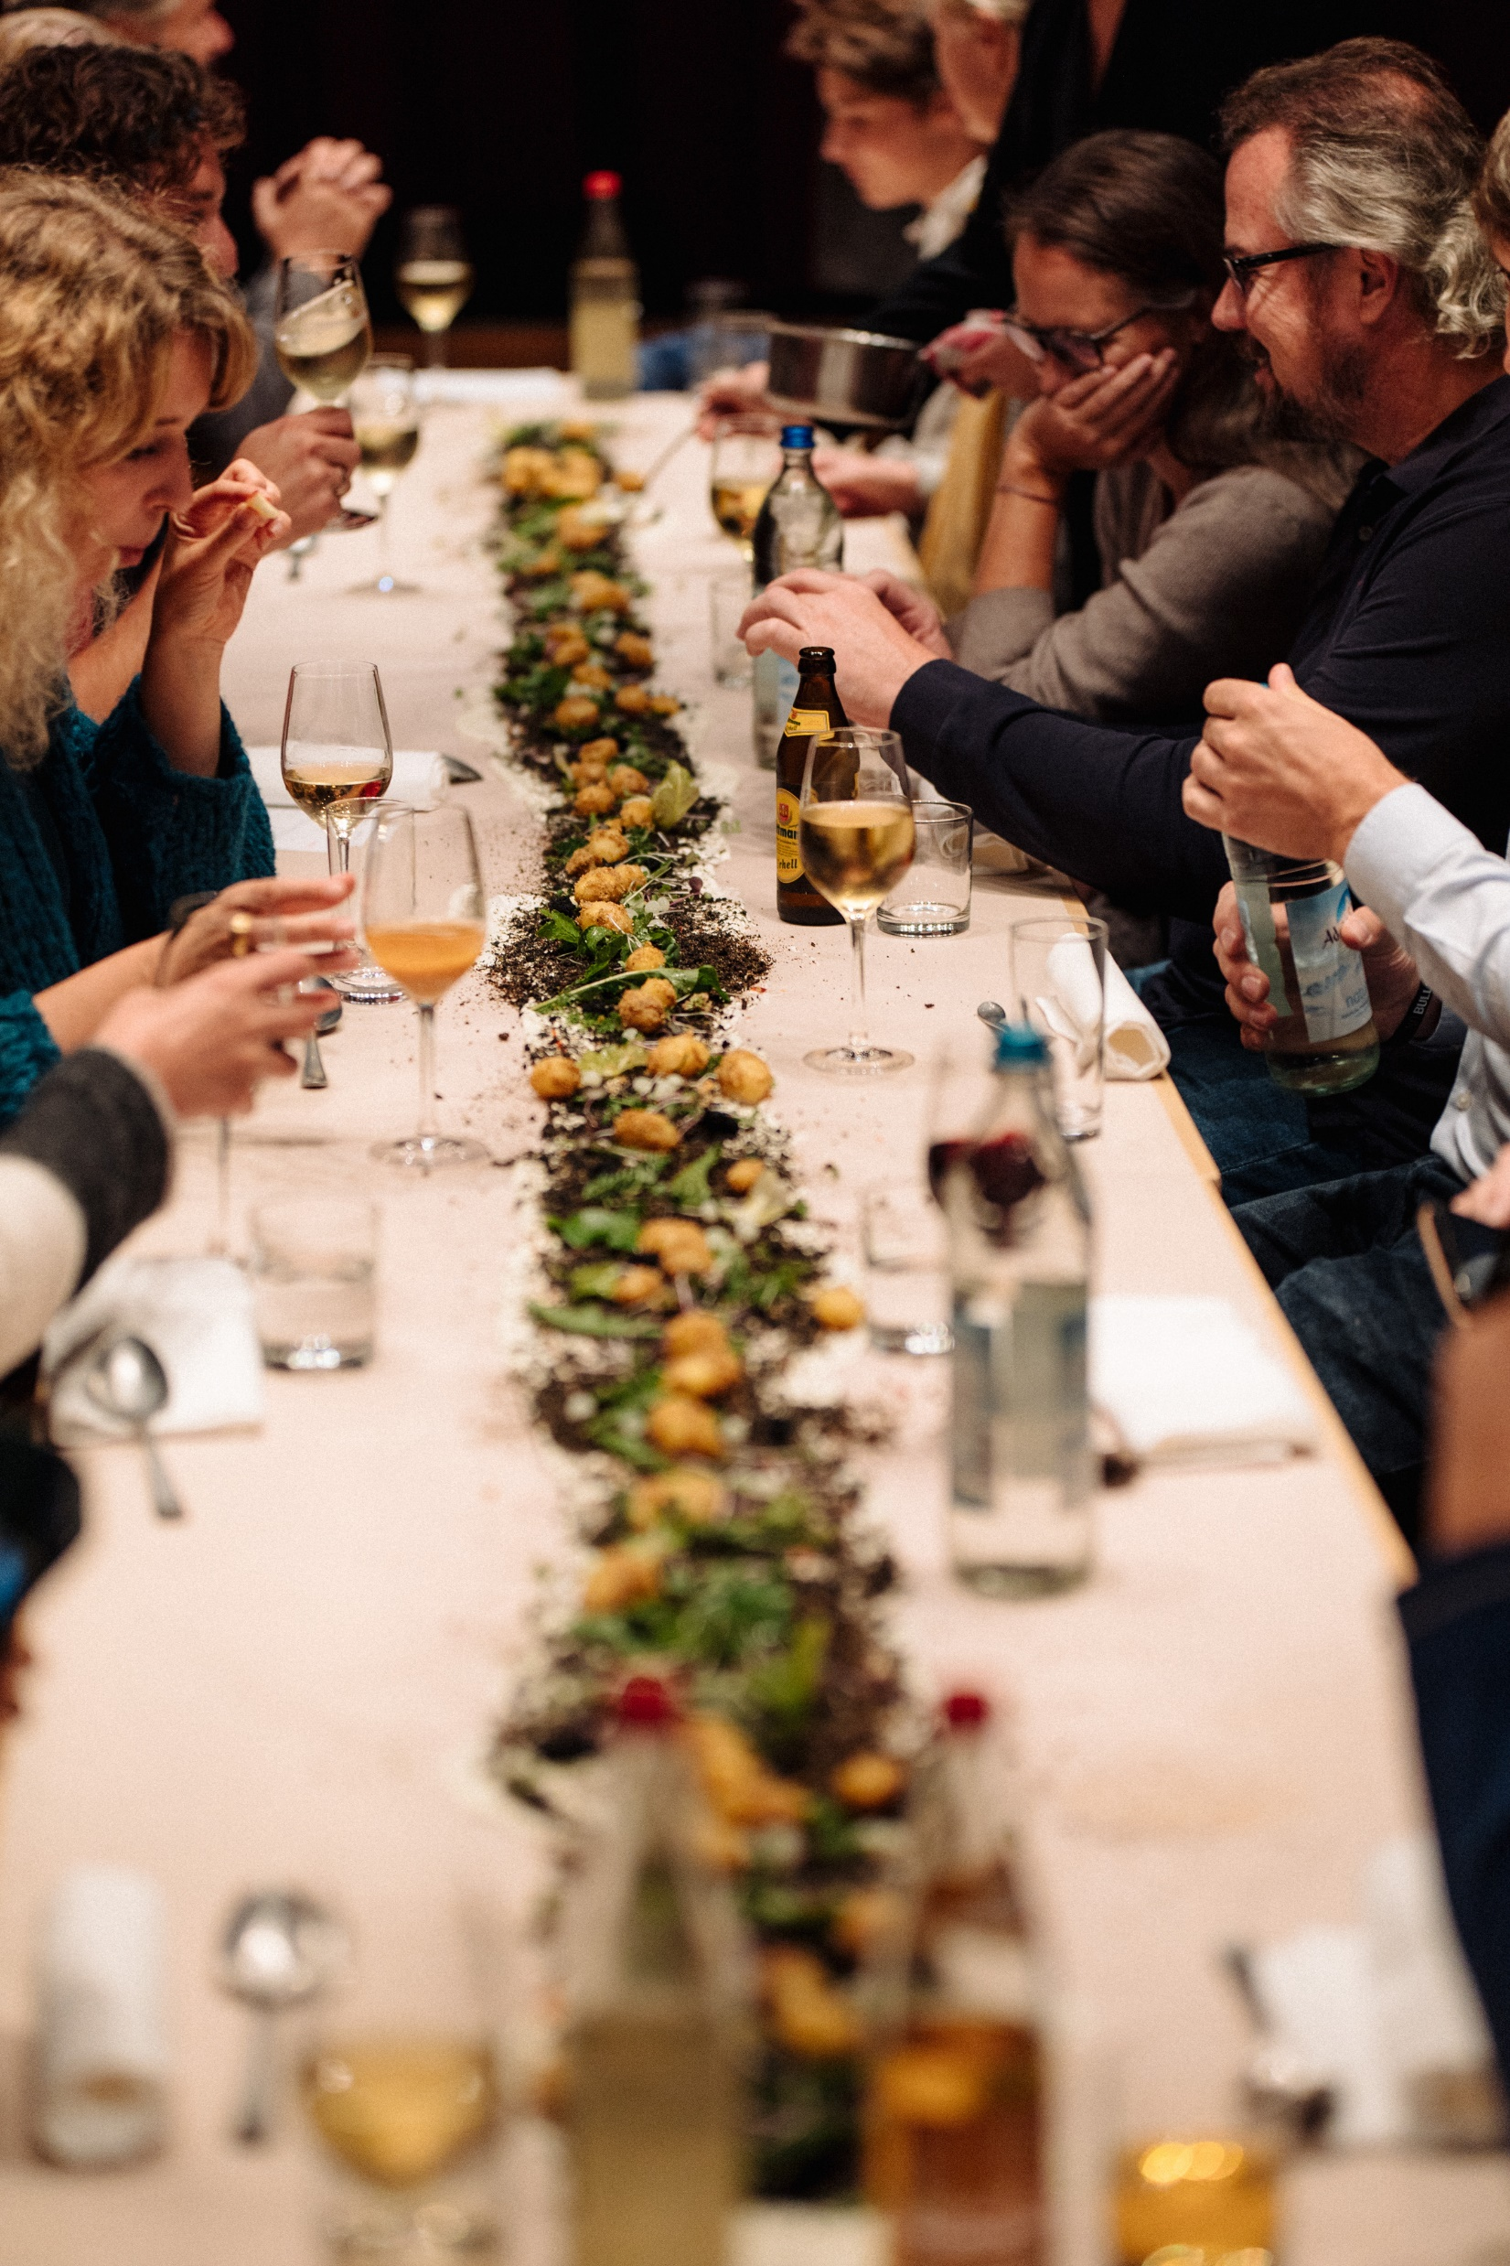
Silicon Vilstal Experience Festival
Startup showcases: Sustainable nutrition
Ideation booths: Social mobility
Living labs:
Circular packaging
Experience Village
Climate dinner
Public
workshops:
Sustainable
region

Slide 5
Rural mobility pilot
Startup lab focused on rural mobility

Slide 6
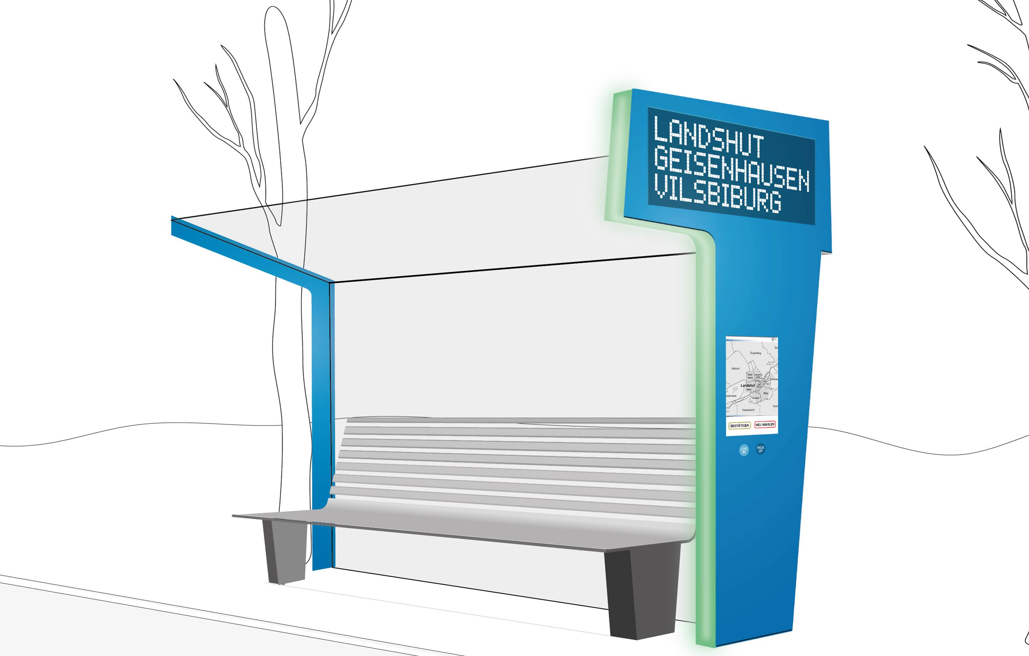
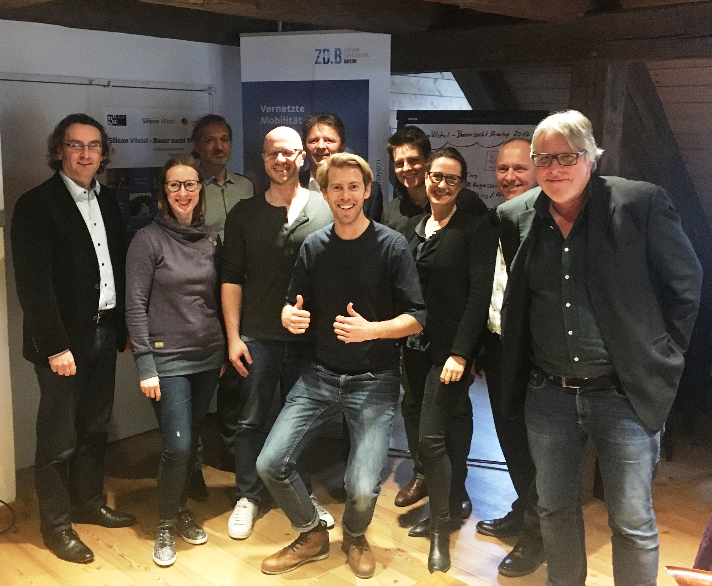
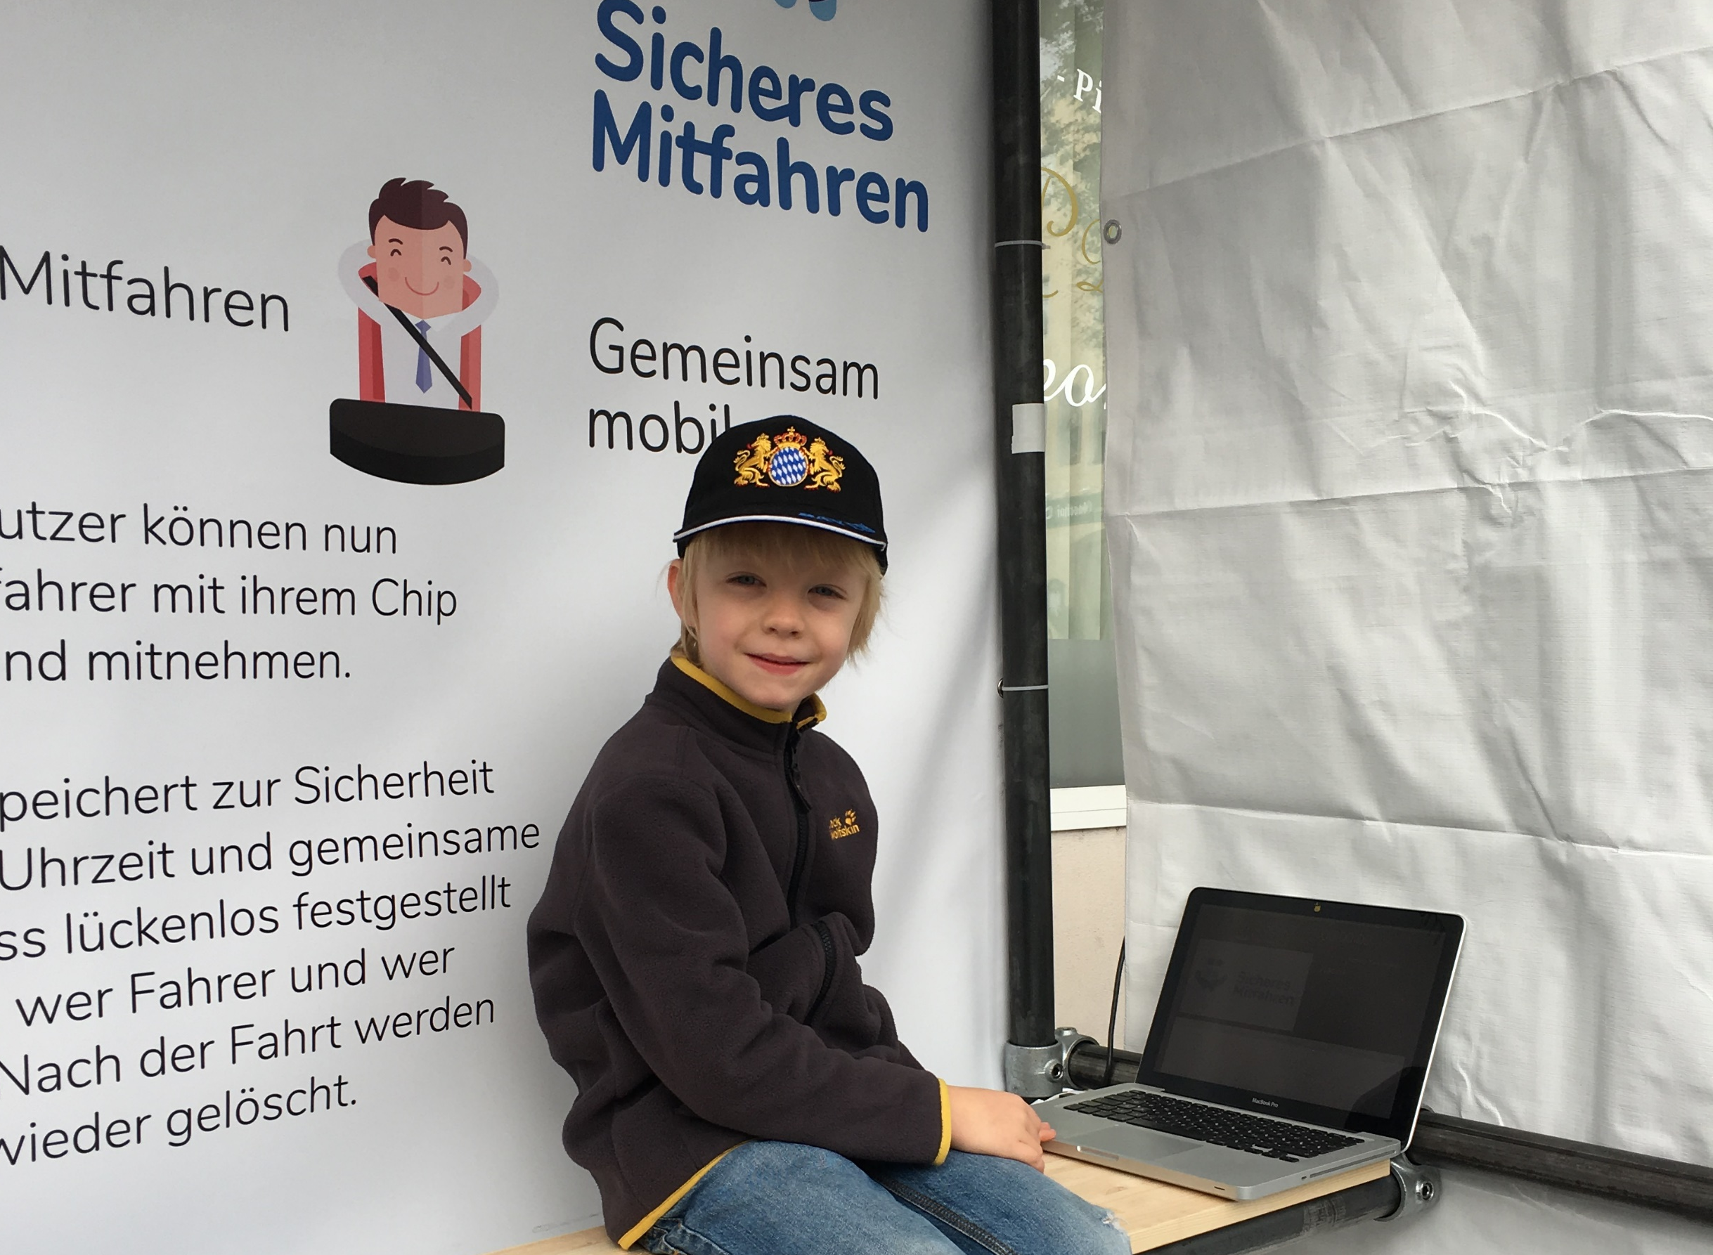
Rural mobility pilot
1
2
1. Startup challenge 2. Jury incl. local mayor = pilot sponsor 3. Pilot test with physical prototypes 4. Experience festival mobility network Next step: continous ridesharing offering
3
4

Slide 7
20km dinner
climate dinner

Slide 8
20km dinner
Festive dinner (Food Experience Design) Ingredients only from within 20km range Traditional rites (photo: edible soil) Feel free to copy! (Free guide available)

Slide 9
www.siliconvilstal.de
info@siliconvilstal.de
@siliconvilstal #siliconvilstal

